Slide 1
Lecture 33: Human-Computer Interaction
CSC111: Introduction to CS through Programming
R. Jordan Crouser
Assistant Professor of Computer Science
Smith College

Slide 2
A quick recap…
Week 0: what is computer science?
Week 1: hardware, python basics, input(…)
Week 2: numbers (floats & ints), math, if statements
Week 3: strings, main(), debugging
Week 4: for and while loops, random, documentation
Week 5: functions
Week 6: lists, dictionaries, ethical code reuse

Slide 3
A quick recap…
Week 7: recursion*, cloud computing*, ongoing research*
Week 8: text adventure games*, MIDTERM
Week 9: classes, inheritance, and OOP
Week 10: graphics, animation, interactive games
Week 11: prototyping
Week 12: files, algorithmic thinking, handling Exceptions

Slide 4
What’s left?
12/3: Advanced Topic: Human-Computer Interaction (HCI)
12/5: Final Project Workshop
12/7: Advanced Topic: TBD
12/10: Last Day of Class: Final Project Demonstrations
12/12: (class cancelled)

Slide 5
What’s left?
12/3: Advanced Topic: Human-Computer Interaction (HCI)
12/5: Final Project Workshop
12/7: Advanced Topic: TBD
12/10: Last Day of Class: Final Project Demonstrations
12/12: (class cancelled)

Slide 6
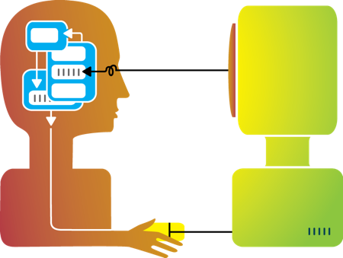
Recap: big idea behind my research
Humans and machines have complimentary strengths
Visualization
Perception
and
context
Interaction
Computational power
Image credit: Ali Ansari

Slide 7
This course so far
How does this part work,
and how to we get it to do what we want?
Computational power
Image credit: Ali Ansari

Slide 8
Today
How do we design ways for humans and machines to interact with one another?
Image credit: Ali Ansari

Slide 9
“Human-Computer Interaction” (def.)
“a discipline concerned with the design, evaluation and implementation of interactive computing systems for human use and with the study of major phenomena surrounding them.”
ACM SIGCHI Curricula for HCI (Hewett et al. 1992)
http://sigchi.org/cdg/cdg2.html

Slide 10

Discussion
Why do we care?
Notes:
How many different “computers” have you encountered since you got up this morning?
How many different “computers” have you encountered in your lifetime?
Have you ever encountered one that was poorly designed?
The way a system is designed effects not only how pleasant the experience is, but (possibly more important) things like productivity, accuracy, safety, etc.

Slide 11
Recap: Interaction (def.)
Ways for the user to affect change in what’s happening in the program
Low level: between human and interface
the set of operations available
happens between the human and the physical computer
High level: between human and problem space
a cognitive act enabled by the interface
happens between the human and the digital objects

Slide 12
Input devices
How many ways can you think of to get information from the human to the computer?

Slide 13




Keyboard
Most common text input device
Allows rapid entry of text by experienced users
Keypress closes connection, causing a char code to be sent
Usually connected by cable, but can be wireless

Slide 14
Mouse
Handheld pointing device
very common
easy to use
Two characteristics
planar movement
buttons used for making a selection, indicating an option, etc.

Slide 15
Touchpad
Small touch-sensitive surface
Used mainly in laptops
‘Acceleration’ is important
Fast stroke
lots of pixels per inch moved
initial movement to the target
Slow stroke
fewer pixels per inch moved
more accurate positioning

Slide 16
Touchscreen
Larger, touch-sensitive surface
Advantages:
fast, no specialised pointer
good for menu selection
easy to clean
Disadvantages:
finger can mark screen
imprecise
lifting arm can be tiring
Notes:
works by interrupting matrix of light beams, capacitance changes or ultrasonic reflections
direct pointing device

Slide 17
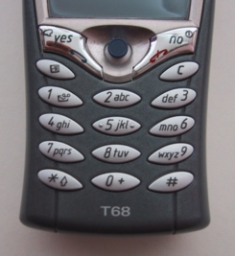
Keypad / T9
Standard: use numeric keys with multiple presses
hello = 4433555[pause]555666
surprisingly fast!
T9 predictive entry
type as if single key for each letter
use dictionary to ‘guess’ the right word
hello = 43556 …
but 26 -> menu ‘am’ or ‘an’

Slide 18
Handwriting recognition
Input text using a “pen” and a “tablet” (more natural?)
Technical problems:
capturing all useful information: stroke path, pressure, etc.
segmenting writing into letters
interpreting individual letters
coping with different styles of handwriting

Slide 19
Speech recognition
Improving rapidly
Most successful when:
single user
limited vocabulary systems
Problems with
external noise
imprecision of pronunciation
large vocabularies
different speakers

Slide 20
Lots of others!

Slide 21
Interaction as a reasoning aid
What kinds of (high level) things might someone want to get the computer to do?
Notes:
Interaction is situated in the context of a problem or goal-directed activity

Slide 22
Yi, Kang, Stasko and Jacko (2007)
Select: mark something as interesting
Explore: show me something else
Reconfigure: show me a different arrangement
Encode: show me a different representation
Abstract/Elaborate: show me more or less detail
Filter: show me something conditionally
Connect: show me related items
Yi, J. S., ah Kang, Y., Stasko, J. T., & Jacko, J. A. (2007). Toward a deeper understanding of the role of interaction in information visualization. Visualization and Computer Graphics, IEEE Transactions on, 13(6), 1224-1231.

Slide 23
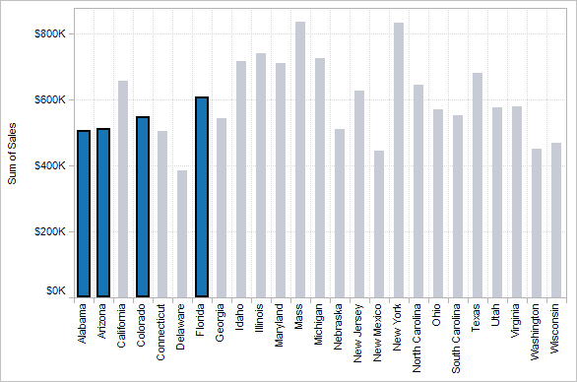
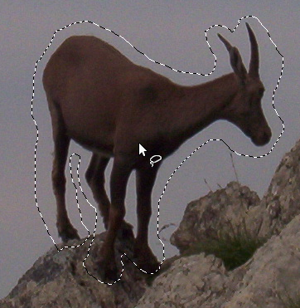

1. Select
“That’s interesting!”

Slide 24
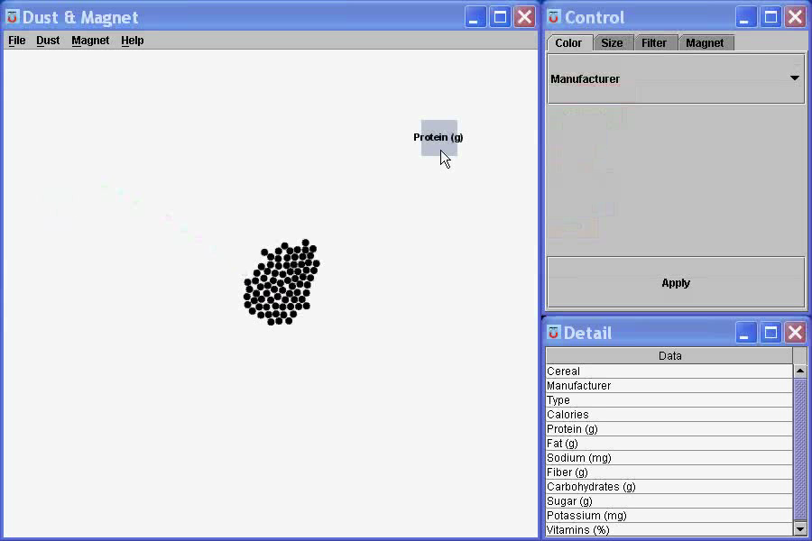
1. Select
“That’s interesting!”
Notes:
What are you selecting? One item at a time?
Selecting of a value?
Selecting of a range?
Selecting of a position on the screen?

Slide 25
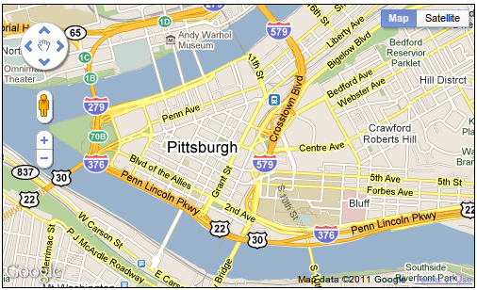
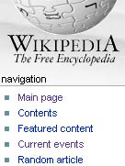
2. Explore
“Show me something else”
Scroll bars
Panning
Direct-Walk (e.g. hyperlink traversal)

Slide 26
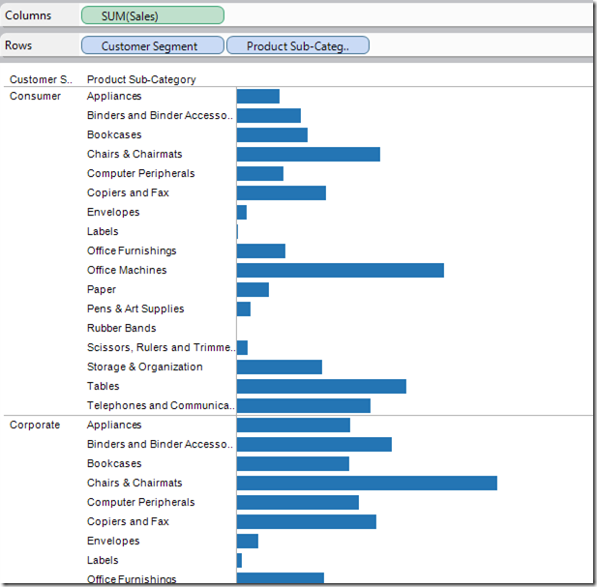
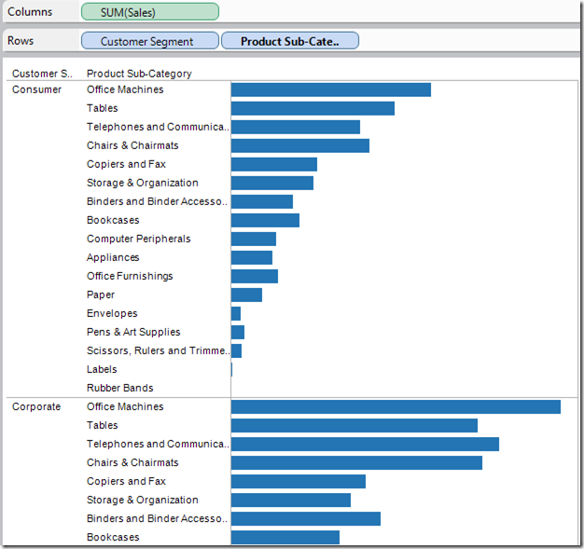
3. Reconfigure
“Show me a different arrangement”: sorting

Slide 27
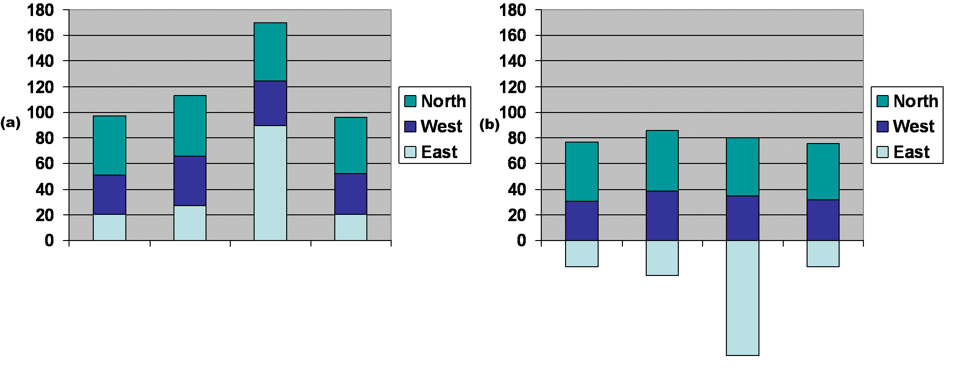
3. Reconfigure
“Show me a different arrangement”: baseline adjustment

Slide 28
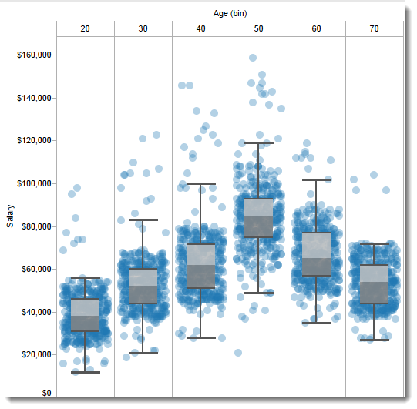
3. Reconfigure
“Show me a different arrangement”: reduce occlusion

Slide 29
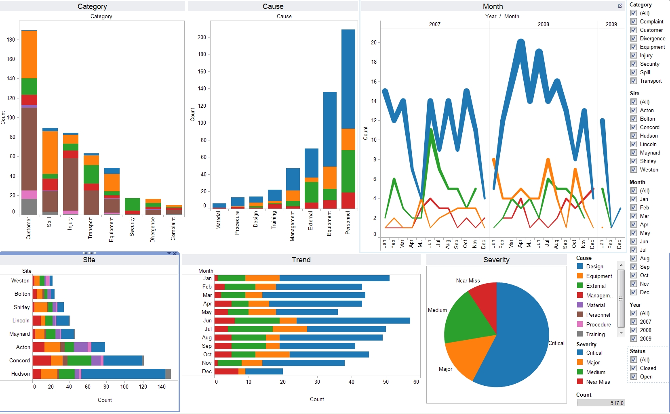
4. Encode
“Show me a different representation”: visualization type, color, size, orientation, etc.

Slide 30
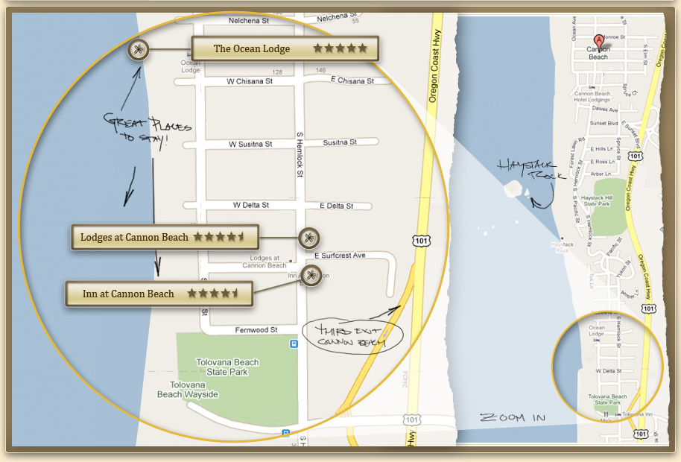
5. Abstract / Elaborate
“Show me more or less detail”: zooming

Slide 31
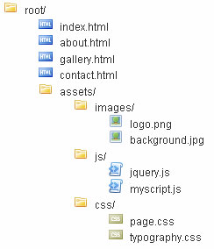
5. Abstract / Elaborate
“Show me more or less detail”: drill up/down

Slide 32
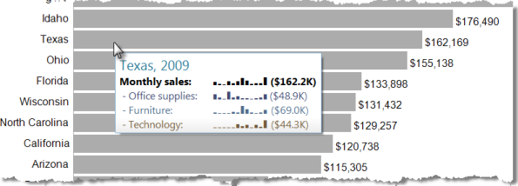
5. Abstract / Elaborate
“Show me more or less detail”: tooltips

Slide 33
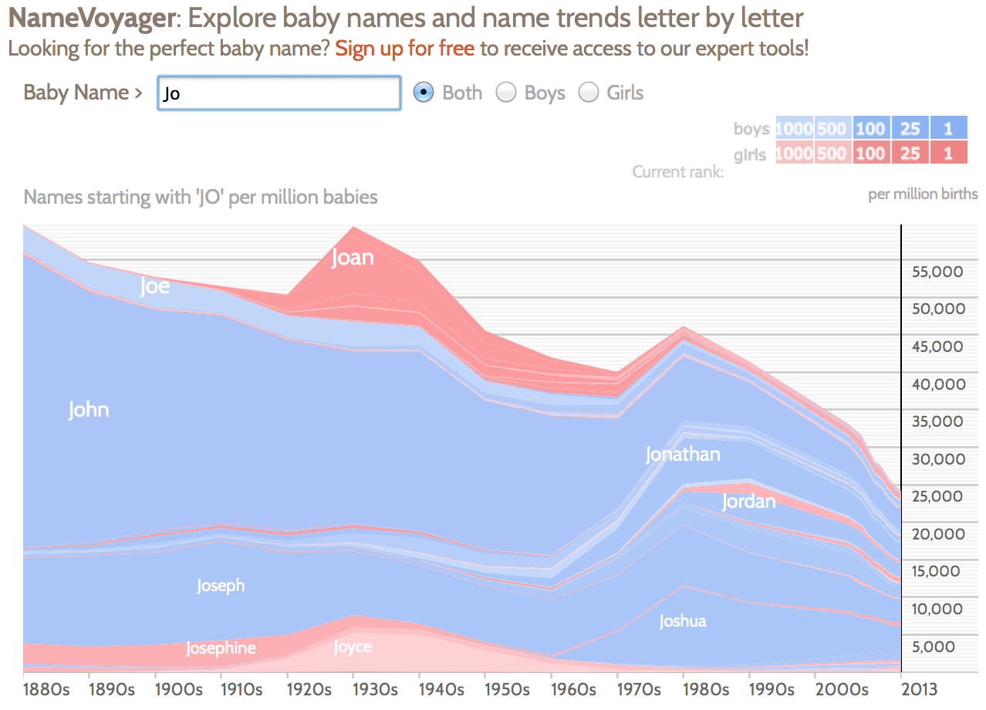
6. Filter
“Show me something conditionally”

Slide 34
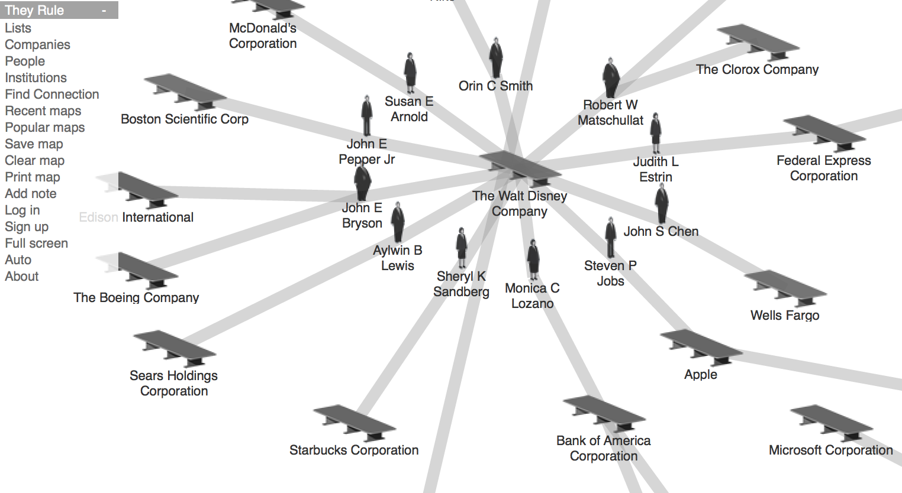
7. Connect
“Show me related items”

Slide 35
Discussion
What’s left to learn?

Slide 36
Some open questions in HCI
Do individual differences matter?

Slide 37
Some open questions in HCI
What about emotion?

Slide 38
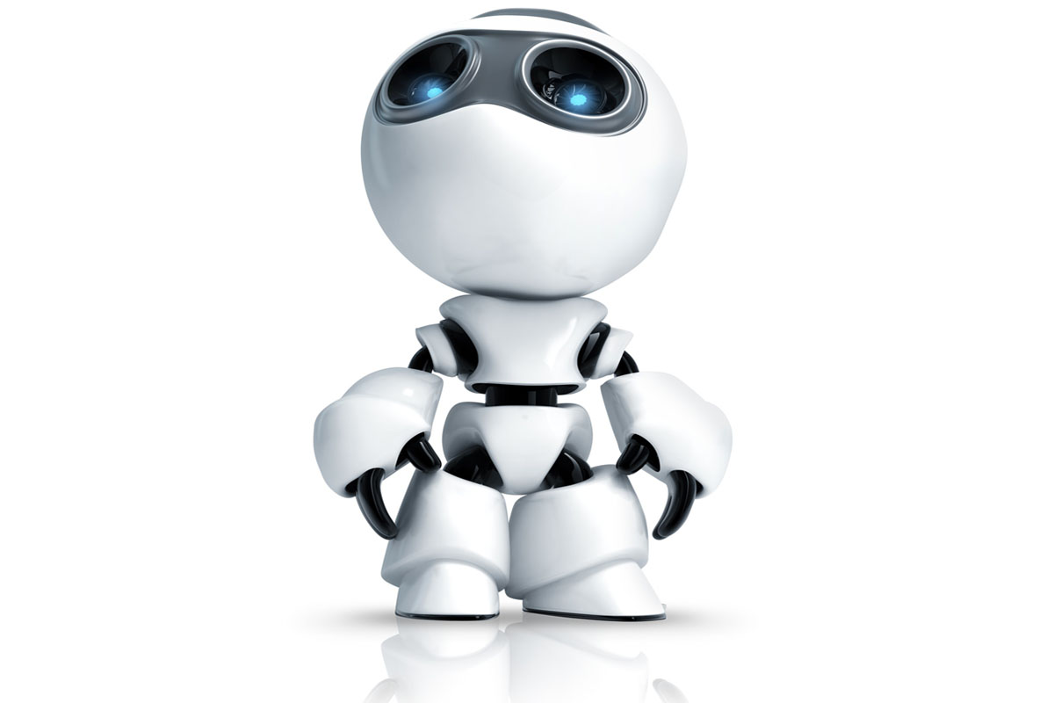
Some open questions in HCI
What about emotion?

Slide 39
Some open questions in HCI
What about scale?

Slide 40
Some open questions in HCI
How do we design for kids?
Are they just smaller grownups, or are they different?

Slide 41
Some open questions in HCI
What about older people?

Slide 42
Some open questions in HCI
What people with limited mobility, vision, hearing, or speech?

Slide 43
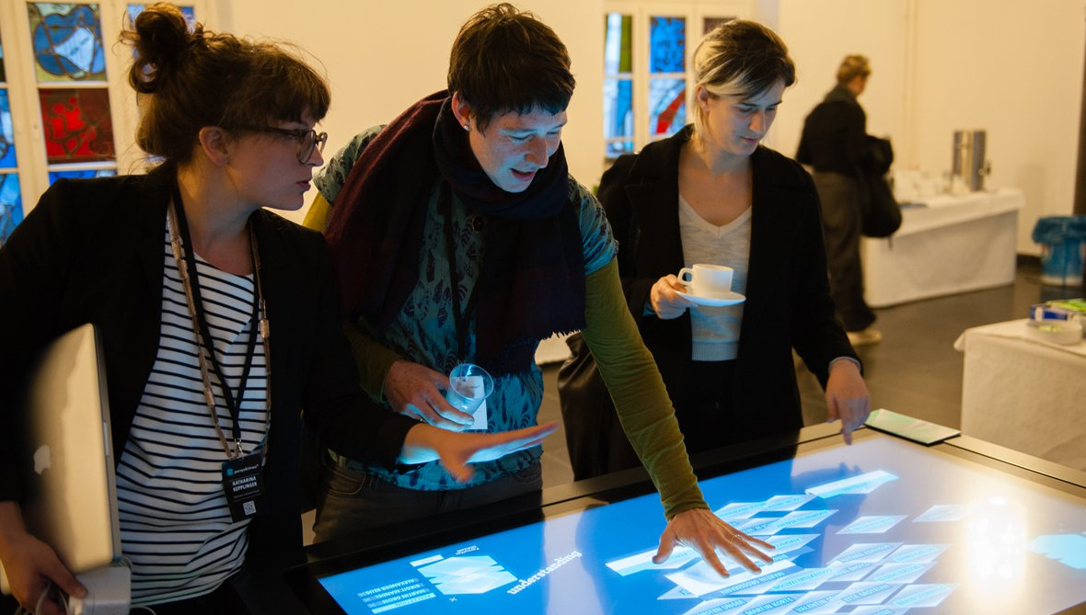
Some open questions in HCI
How do we design tools that support collaboration?

Slide 44
Some open (ethical) questions in HCI
How does interacting through a computer influence decision-making?
How does it change human relationships?
Are we obligated to design only systems that improve human life, or should we explore other interactions? (i.e. ones that are cumbersome, difficult, scary,…)

Slide 45
Discussion
What do you think we should be asking?

